Slide 1
AdaBoost (Adaptive Boosting)
AdaBoost (Adaptive Boosting) is an ensemble learning technique that combines multiple weak classifiers to create a strong model. It works by sequentially focusing more on the misclassified data points from previous models, effectively reducing bias and variance, making it useful for regression tasks as well as classification tasks.
Trains models sequentially, each correcting previous errors
Assigns higher weights to misclassified samples
Final prediction is made using weighted voting
This approach allows AdaBoost to improve its performance on difficult cases by progressively focusing on previously misclassified examples, ultimately creating a robust ensemble model.

Slide 2
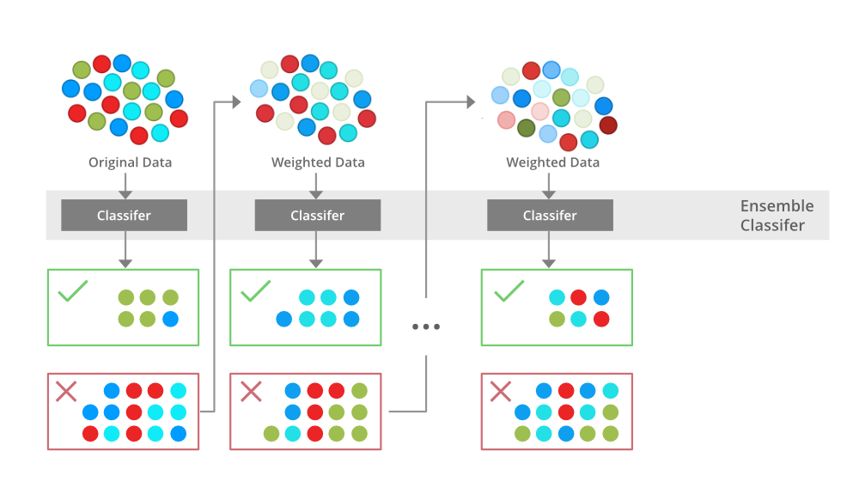
Adaboost Working
AdaBoost (Adaptive Boosting) assigns equal weights to all training samples initially and iteratively adjusts these weights by focusing more on misclassified data points for the next model. It effectively reduces bias and variance making it useful for classification tasks but it can be sensitive to noisy data and outliers.

Slide 3
The above diagram explains the AdaBoost algorithm in a very simple way.
Let’s try to understand it in a stepwise process:
Step 1: Initial Model (B1)
The dataset consists of multiple data points (red, blue and green circles). Equal weight is assigned to each data point. The first weak classifier attempts to create a decision boundary. 8 data points are wrongly classified.
Step 2: Adjusting Weights (B2)
The misclassified points from B1 are assigned higher weights (shown as darker points in the next step). A new classifier is trained with a refined decision boundary focusing more on the previously misclassified points. Some previously misclassified points are now correctly classified. 6 data points are wrongly classified.
Step 3: Further Adjustment (B3)
The newly misclassified points from B2 receive higher weights to ensure better classification. The classifier adjusts again using an improved decision boundary and 4 data points remain misclassified.
Step 4: Final Strong Model (B4 - Ensemble Model)
The final ensemble classifier combines B1, B2 and B3 to get strengths of all weak classifiers. By aggregating multiple models the ensemble model achieves higher accuracy than any individual weak model.

Slide 4
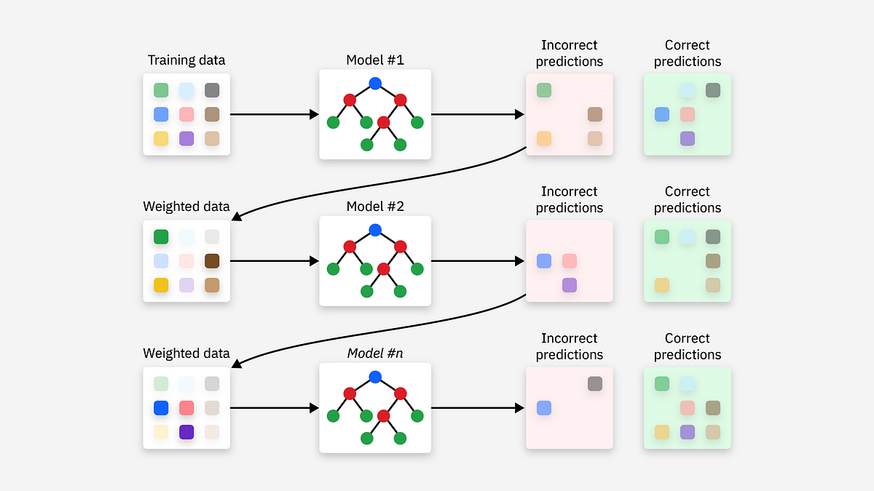
Example 2

